Slide 1
Review of DC motors and their selection in Mechatronics systems

Slide 2
Actuators
An actuator is a component of machines that is responsible for moving or controlling a mechanism or system. An actuator requires a control signal and source of energy. The control signal is relatively low energy and may be electric voltage or current, pneumatic or hydraulic pressure, or even human power.

Slide 3
Actuator System
An actuator system has four components:
1. Electric Motor
2. Power Converter
- Rectifiers
- Choppers
- Inverters
- Cycloconverters
3. Controllers – matching the motor and power converter to meet the load requirements
4. Load

Slide 4
Electric Motors
Electric motors presently used for speed control applications are:
DC excited
Shunt
Series
Compound
Separately excited
Switched reluctance motors
2. AC Excited
Induction
Wound rotor synchronous
Permanent magnet synchronous
Reluctance motors

Slide 5
Fundamental of rotating machines
Energy converter
Output
power
Rotating machine
Input power
Overview of motor construction

Slide 6
Power flow in rotating motors
Power Input
P_{in}
Power Output
P_{out}
Rotating motor
Power output = Power input - Losses
Power input, P_{in} = V_{in} I_{in} for a DC motor
= V_{in} I_{in} cosφ for a single phase motor
= for a 3-phase motor
Note: φ is the phase angle between phase voltage and phase current
Power output,
; N is in RPM
Efficiency

Slide 7
Operating principle of rotating motors
Fleming’s Left Hand Rule
B
F = i L X B
F = BiL ; F is perpendicular to both B and I (L)

Slide 8
Force on a charge
Stationary charge in an electric field:
F - Force on charge Q
E - electric field intensity
F = Q E
Charge in motion or the moving charge in a magnetic field :
F = Q v X B
Combination of electric and magnetic field
F = Q(E + v X B)
is known as Lorentz force equation

Slide 9
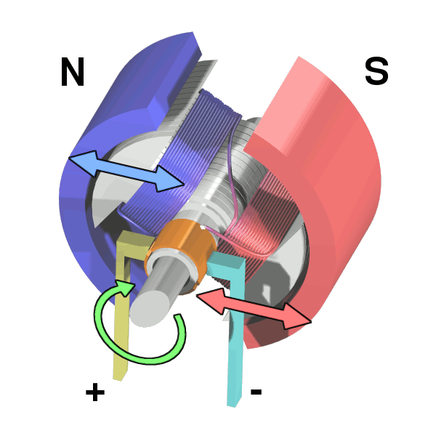
Brushed DC Motors Review
A winding assembly (armature) within a stationary magnetic field
Brushes and Commutators switch current to different windings in correct relation to the outer permanent magnet field.
Pros:
Electronic control is simple, no need to commutate in controller
Requires only four power transistors
Cons:
A sensor is required for speed control
The brushes and commutator create sparks and wear out
Sparks limit peak power
Heat in armature is difficult to remove
Low power density

Slide 10
Mechanical bearing - Ball bearing
Wear and tear Lubrication

Slide 11
Typical stator winding, commutator and brush of a DC motor

Slide 12
Cross-sectional view of motor

Slide 13
Laminations of rotating motor
(a) Pictorial view of laminations of dc motor (b) Lamination of induction motor

Slide 14
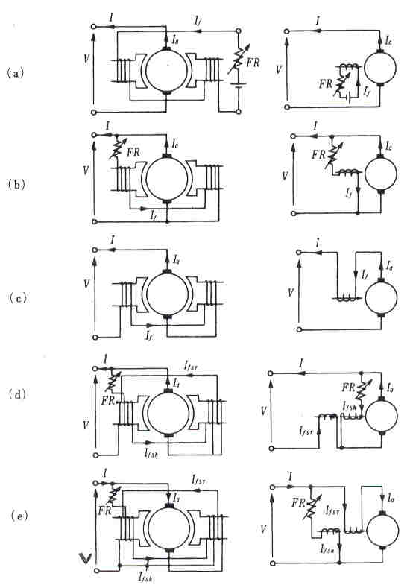
Different connections of DC motors with field winding
Separately excited
Shunt excited
(c) Series excited
(d) Short-shunt
compound excitation
(e) long-shunt
compound excitation.

Slide 15
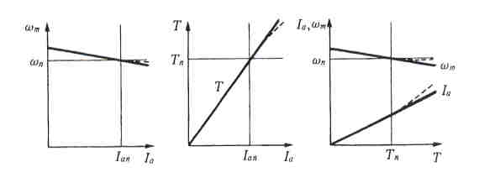
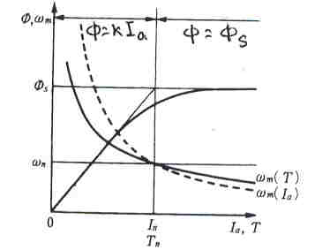
Characteristics of DC shunt motor
Characteristics of DC series motor

Slide 16
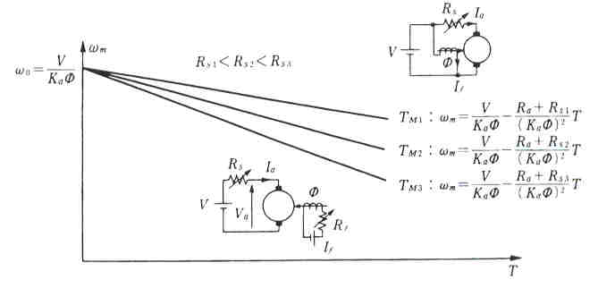
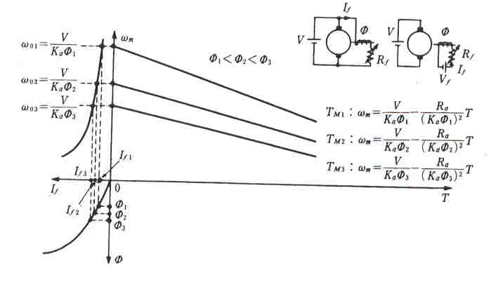
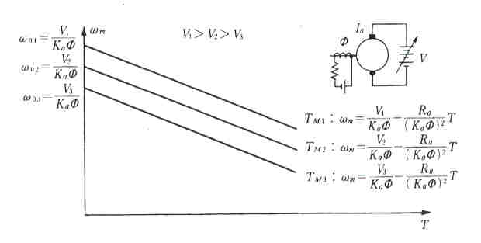
Speed control of DC motor
Speed control through Armature resistance
Speed control through Field flux
Speed control through terminal voltage

Slide 17
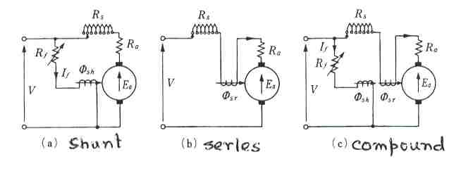
Starting of DC motors

Slide 18
Losses in rotating motors
I²R loss (Copper loss): Motor winding (both in stator and rotor)
Magnetic loss: Combination of eddy current and hysteresis loss
Friction and windage loss: Also known as rotational loss or mechanical loss.
What these losses will do?
They manifested themselves in the form of HEAT and increases the temperature of the winding of the motor. Cooling FAN is required to maintain the TEMPERATURE rise.

Slide 19
Magnetic losses in material due to alternating magnetic field
Hysteresis loss
W/m³
Eddy current loss
W/m³

Slide 20
The following equations are used to analyze the operation of DC motor
Torque equation
Also
The mechanical power output is P_{m} = T ω_{m}.
So, E_{a} I_{a} = K_{a}φω_{m}I_{a} = ω_{m} K_{a}φI_{a} = ω_{m} T
So the power developed = output power.

Slide 21
Mathematical model for starting performance
The electric circuit equation is given by
The dynamic equation of the motor under no-load condition is given by
The motor torque, T, is given by
T = K_{a} φ i_{a} = k_{t}i_{a} ;
φ is kept constant for PM DC motor, k_{t} is a constant and is known as armature constant.
The back emf, e, is given by
e = K_{a} φ ω = k_{e} ω ; k_{e} is a constant and is known as motor constant. Usually k_{e} is equal to k_{t}
At t = 0, both i_{a} and ω are 0

Slide 22
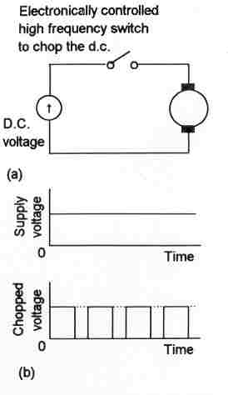
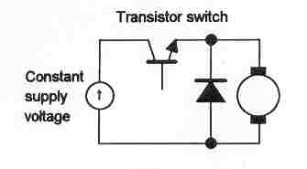
Power electronics based control of DC motor

Slide 23
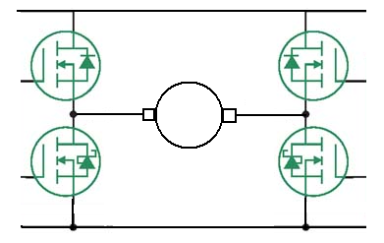
DC Motor H-Bridge
The DC motor needs four transistors to operate the DC motor
The combination of transistor is called an H-Bridge, due to the obvious shape
Transistors are switched diagonally to allow DC current to flow in the motor in either direction
The transistors can be Pulse Width Modulated to reduce the average voltage at the motor, useful for controlling current and speed
1
0
0
1
0
1
1
0

Slide 24
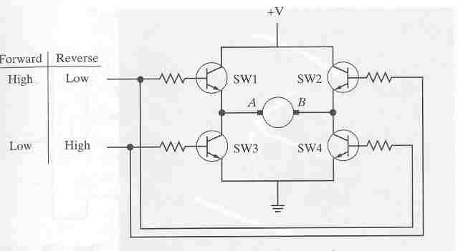
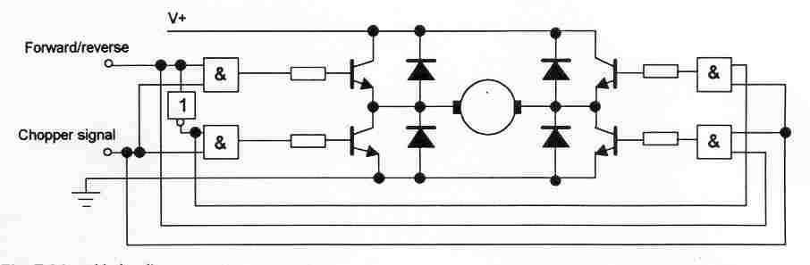

Slide 25
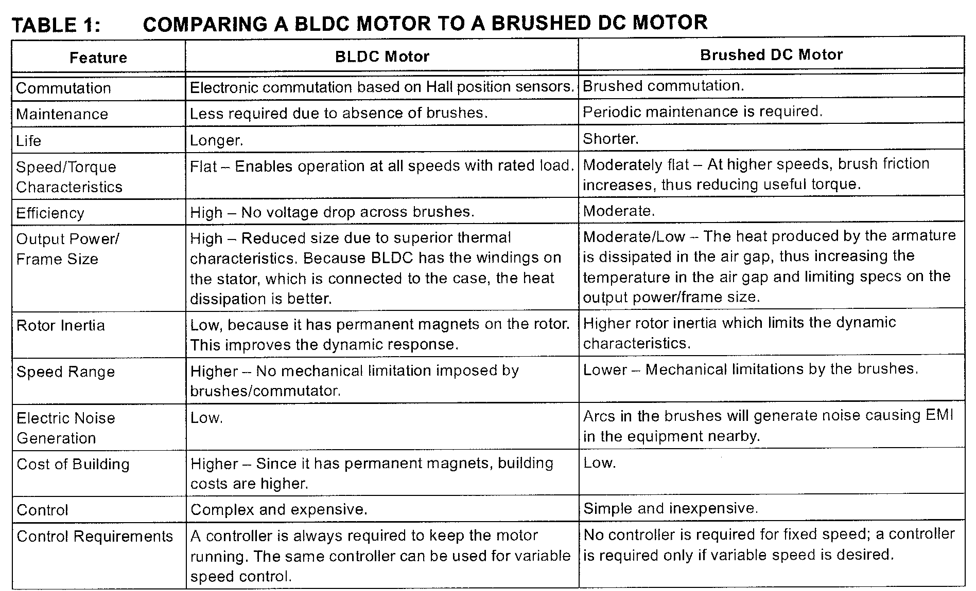

Slide 26
Selection of Motors
1. Cost
2. Thermal capacity
3. Efficiency
4. Torque-speed profile
5. Acceleration
6. Power density, volume of the motor
7. Ripple, cogging torque
8. Peak torque capability
9. Suitability for hazardous environment
10. Availability of spare parts
Cog: Mechanical transmission; Gear; Toothed wheel

Slide 27
Actuator system for Sydney Trains and Metro
T set
Traction motors | 4 × 170 kW (230 hp) 2-phase DC shunt-wound motor MB-3303-B (Mitsubishi Electric)
Power output | 680 kW (910 hp) (4-car) 1,360 kW (1,820 hp) (8-car)
Electric system(s) | 1,500 V DC catenary
Current collection method | Pantograph
M set
Traction system | IGBT-VVVF (Alstom ONIX 1500)
Traction motors | 4 × 226 kW (303 hp) 3-phase AC induction motor (Alstom ONIX 1500)
Power output | 904 kW (1,212 hp) (4-car) 1,808 kW (2,425 hp) (8-car)
Electric system(s) | 1,500 V DC catenary
Overhead Rigid Conductor Rail System (ORCS)

Slide 28
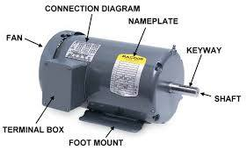
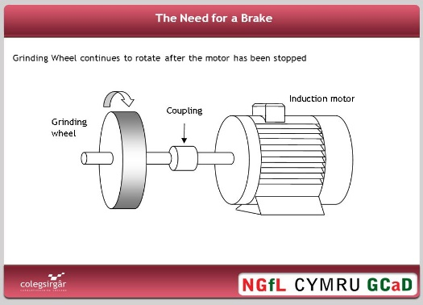
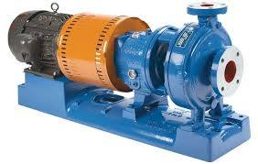
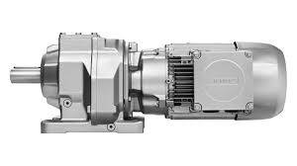
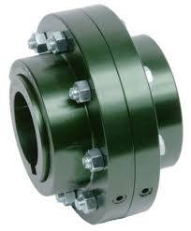
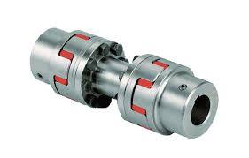
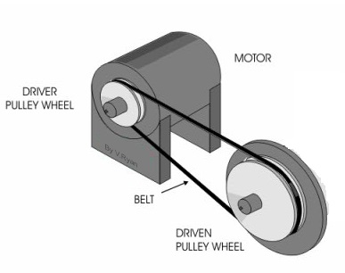
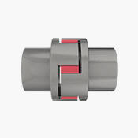
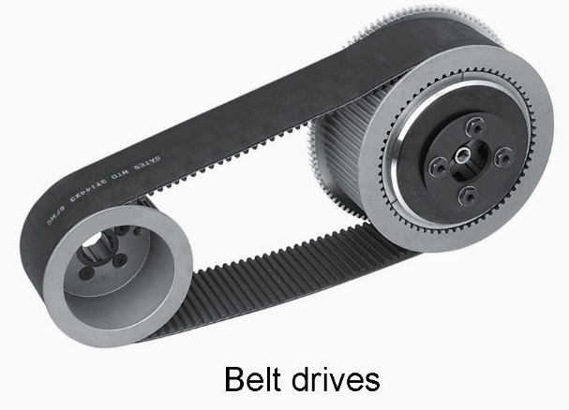
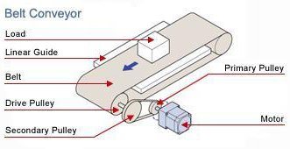
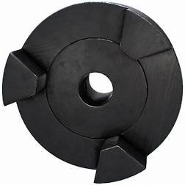
Coupling of loads with motor:
Drive shaft
Jaw coupling

Slide 29
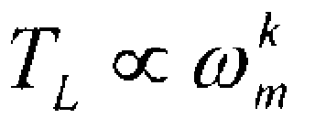
Load
The motor drives a load which has a certain characteristics torque-speed requirement.
In general,
where, k may be an integer or a fraction.

Slide 30
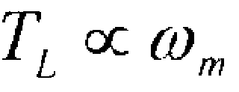
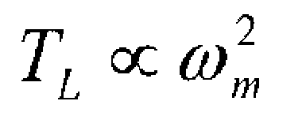
Load
In a feed drive,
In fans and pumps,
The motor can be connected to the load through a set of gears
The gears have teeth ratio and can be treated as torque transformers

Slide 31
Load
The gears are used to amplify the torque on load side at lower speed compared to the motor speed
The motors are designed to run at high speeds because it has been found that the higher the speed, the lower is the volume and size of the motor

Slide 32
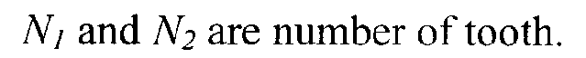
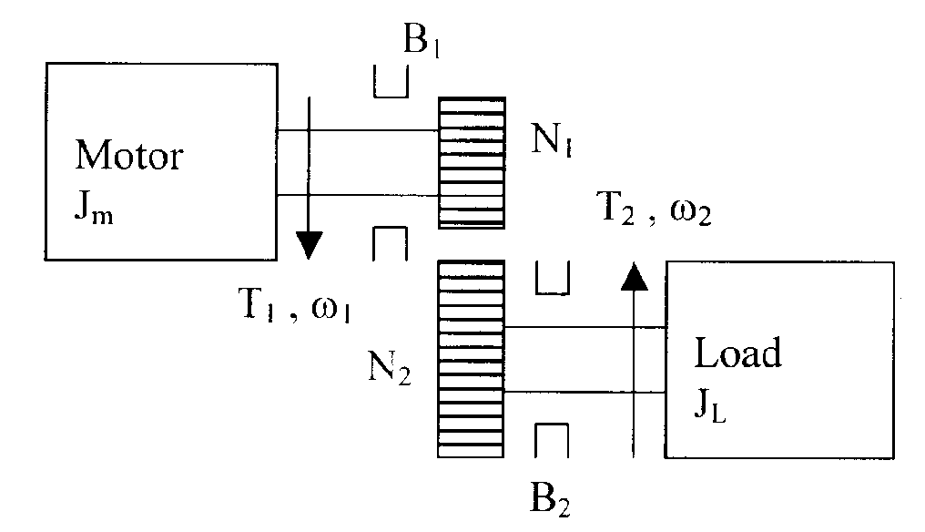
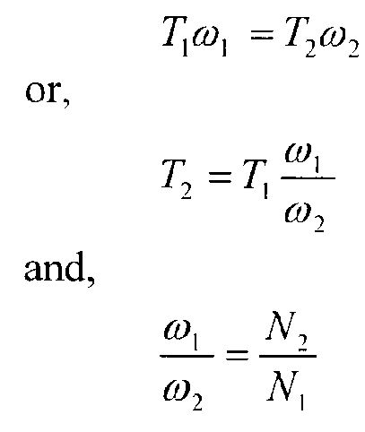
Motor-load connection through a gear
The following laws govern the gear system operation:
1) The power handled by the gear is the same on both sides
2) Speed on each side is inversely proportional to its tooth number,

Slide 33
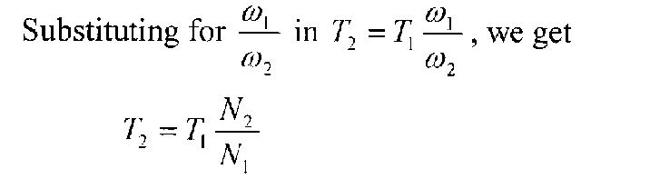
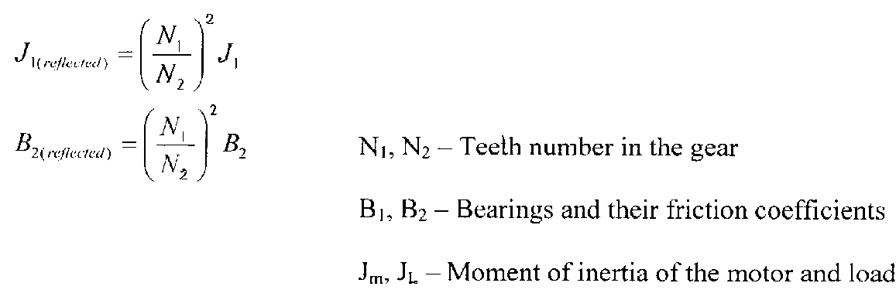
Gear connected Load
Similar to the case of transformer, the constants of the load as reflected to the motor is:

Slide 34
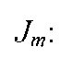
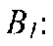
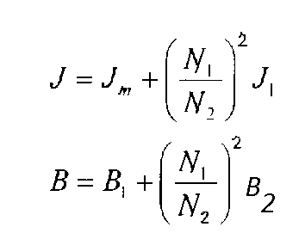
Motor-load connection through a gear
Hence, the resultant mechanical constants are,
moment of inertia of motor
friction due to motor bearing

Slide 35
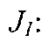
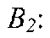
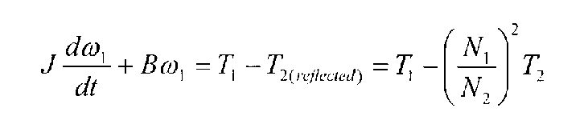
Motor-load connection through a gear
moment of inertia of gear system and load
friction due to gear system and load
The torque equation of the motor-load combination is:

Slide 36
Control of Electric Motors
Servo Controllers: offer extremely fast response and precise control of acceleration/ deceleration, speed and torque. Servo Control Systems can accelerate from standstill to 100 RPM in several milliseconds.
Servo Control Systems are designed with three feedback loops:
Position loop
Velocity loop
Current loop

Slide 37
Control of Electric Motors
Elements of Servo Control System are:
1) Motor
2) Power Converter
3) Load and Transmission Systems
4) Encoder (position transducer)
5) Tachometer (speed transducer)
6) Current and Voltage Sensors
7) Potentiometers

Slide 38
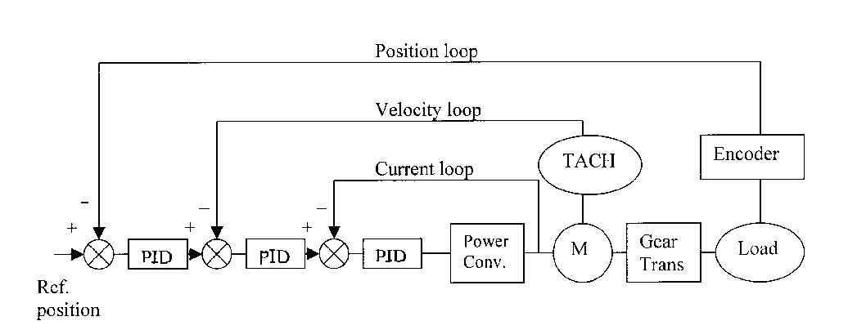
Control of Electric Motor

Slide 39
Load Characteristics
The process of selecting an adjustable AC or DC drive is one where load is primary consideration.
When considering load characteristics, the following should be evaluated:
What type of load is associated with the application ?
What is the size of the load?

Slide 40
Load Characteristics
Does the load involve heavy inertia ?
What are the motor considerations ?
Over what speed range are heavy loads encountered ?

Slide 41
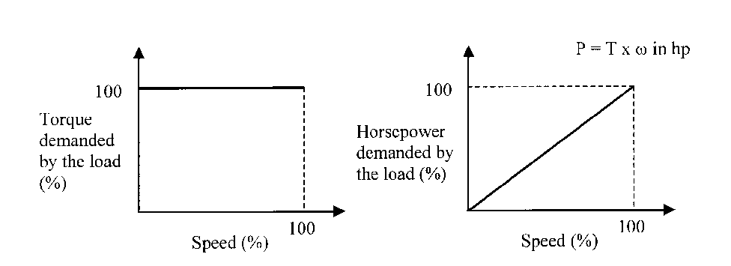
Load Types
Constant Torque Load
In this group, the torque demanded by the load is constant throughout the speed range
Loads of this type are essentially friction loads
Examples: Conveyors, Extruders, and Surface Winders

Slide 42
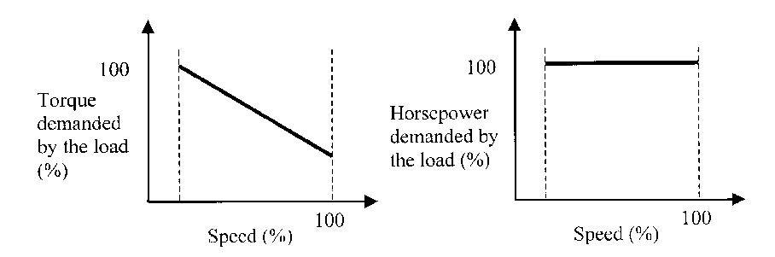
Load Types
Constant horsepower Load
The horsepower demanded by the load is constant within the speed range. The load requires high torque at low speeds.
Examples: Center-driven winders and Machine tool spindles

Slide 43
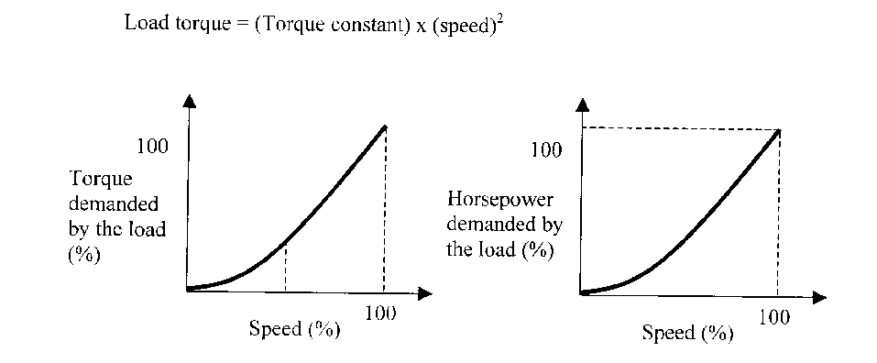
Load Types
Variable torque load

Slide 44
Power and torque characteristics of Load
Constant horsepower, torque varies inversely with speed
Applications: Metal cutting tools operating over wide speed range, mixer, extruder and special machines where operation at low speed may be continuous

Slide 45
Power and torque characteristics of Load
Constant torque, horsepower varies as the speed
Applications: General machinery hoists, conveyors, printing press

Slide 46
Power and torque characteristics of Load
Horsepower varies as square of the speed, torque varies with speed
Applications: Positive displacement pumps, some mixers, some extruders

Slide 47
Power and torque characteristics of Load
Horsepower varies as cube of the speed, torque varies as square of speed
Applications: All centrifugal pumps and some fans (Note that fan power may vary as the power of speed)

Slide 48
Power and torque characteristics of Load
High inertial loads
Applications: Are typically associated with machines using flywheel to supply most of the operating energy, punch press

Slide 49
Power and torque characteristics of Load
Shock loads
Applications: Drives of crushers, separators, grinders, conveyors, and vehicular systems
Power converters and motors can be damaged if they are not protected from the overload conditions

Slide 50
Stator and Rotor
Typical stator construction

Slide 51
Typical rotor construction
Induction motor

